Slide 1
Applied Physics(C. Sc.) BS CS Semester-I Course Code: L-15(Lenses, Prisms) IUB & All Affiliated Colleges. Reality Awards Boost Up (YT-Channel)
Rushmat Ali
Assistant Professor OF Physics
Govt. Kh. F. Graduate College R. Y. Khan

Slide 2
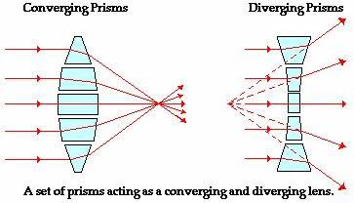
What Are Lenses?
A lens is a transmissive optical device that focuses or disperses light beams using refraction. A simple lens consists of a single piece of transparent material, while compound lenses consist of several simple lenses arranged along with a common axis. A lens can focus light to form an image, unlike a prism, which refracts light without focusing.
Lenses are made from materials such as glass or plastic and are ground, polished, or molded to the required shape. A lens can focus light to form an image, unlike a prism, which refracts light without focusing. Devices that similarly focus or disperse waves and radiation other than visible light are also called "lenses", such as microwave lenses, electron lenses, acoustic lenses, or explosive lenses.
History Of Lenses:
The word lens comes from lēns, the Latin name of the lentil (a seed of a lentil plant), because a double-convex lens is lentil-shaped. The lentil also gives its name to a geometric figure
Nimrud lens is a rock crystal artifact dated to the 7th century BCE which may or may not have been used as a magnifying glass, or a burning glass
Both Pliny and Seneca the Younger (3 BC–65 AD) described the magnifying effect of a glass globe filled with water.
Between the 11th and 13th century "reading stones" were invented.
Spectacles were invented as an improvement of the "reading stones" of the high medieval period in Northern Italy in the second half of the 13th century.
With the invention of the telescope and microscope there was a great deal of experimentation with lens shapes in the 17th and early 18th centuries by those trying to correct chromatic errors seen in lenses.
During the 20th century, cheap, lightweight, reliably made plastics became widely available and most low-cost optical devices now use plastic lenses (sometimes known as "organic glass"—made from materials such as polycarbonate) in place of glass ones (sometimes known as "mineral glass" to differentiate it from plastic equivalents). Disposable contact lenses, for example, became possible with the arrival of cheap, mass-produced, high-quality plastics—and, if you wear eyeglasses or have a camera on your phone, the lenses will almost certainly be plastic ones.

Slide 3
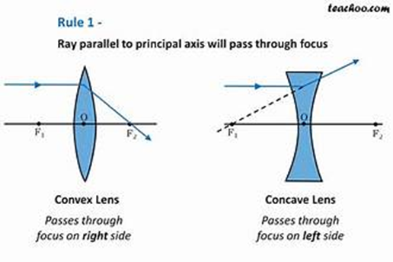
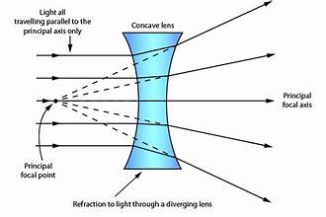
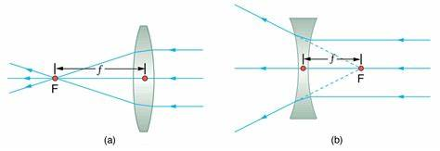
Standard Definitions About Lenses:

Slide 4
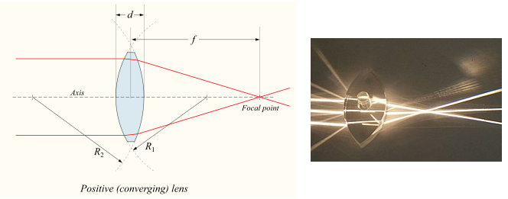
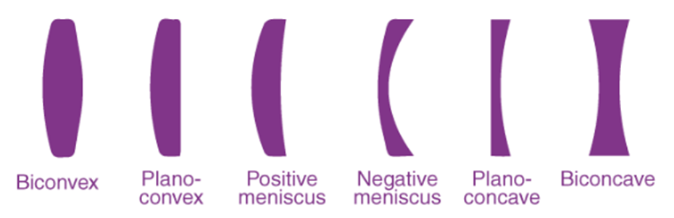
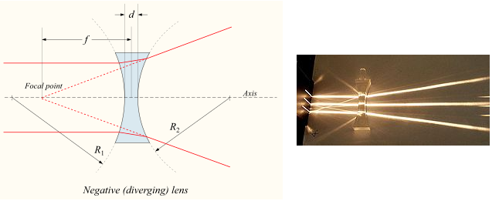
Types of Lenses:
The lens classification depends on how the light rays bend when they pass through the lens. Lenses are classified by the curvature of the two optical surfaces. The two main types of lenses are:
Convex Lens (Converging)
Concave Lens (Diverging)
Convex lenses are thick in the middle and thinner at the edges. A concave lens is flat in the middle and thicker at the edges. A convex lens is also known as the converging lens as the light rays bend inwards and converge at a point which is known as focal length. On the other, the lens is also known as a diverging lens because it bends the parallel light rays outward and diverges them at the focal point.
Simple lens and compound lens are the two classifications of lenses. Simple lenses are different from compound lenses based on their surface of curvature. Following are the different types of simple lenses.
Non spherical types
An aspheric biconvex lens.
Cylindrical lenses have curvature along only one axis. They are used to focus light into a line, or to convert the elliptical light from a laser diode into a round beam. They are also used in motion picture anamorphic lenses.
Aspheric lenses have at least one surface that is neither spherical nor cylindrical. The more complicated shapes allow such lenses to form images with less aberration than standard simple lenses, but they are more difficult and expensive to produce. These were formerly complex to make and often extremely expensive, but advances in technology have greatly reduced the manufacturing cost for such lenses.
Close-up view of a flat Fresnel lens.
A Fresnel lens has its optical surface broken up into narrow rings, allowing the lens to be much thinner and lighter than conventional lenses. Durable Fresnel lenses can be molded from plastic and are inexpensive.
Lenticular lenses are arrays of microlenses that are used in lenticular printing to make images that have an illusion of depth or that change when viewed from different angles.
Bifocal lens has two or more, or a graduated, focal lengths ground into the lens.
A gradient index lens has flat optical surfaces, but has a radial or axial variation in index of refraction that causes light passing through the lens to be focused.
An axicon has a conical optical surface. It images a point source into a line along the optic axis, or transforms a laser beam into a ring.[28]

Slide 5
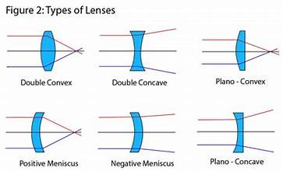
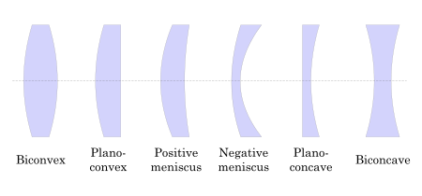
A simple lens consists of a single piece of transparent material.
Simple lenses are different from compound lenses based on their surface of curvature.
Following are the different types of simple lenses.
Compound lenses are those constructed out of a combination of different simple lenses.
The lens types used to build a compound lens may have different refractive indices and other properties.
The placement of lenses are such that they lie on a single axis, and properties like focal length are calculated again for the new compound lens.

Slide 6
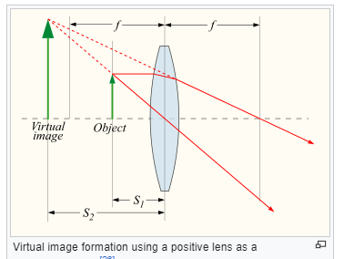
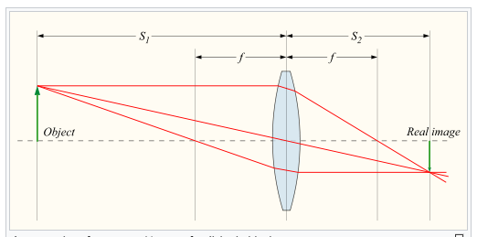


Thin Lens Approximation:
As mentioned above, a positive or converging lens in air focuses a collimated beam travelling along the lens axis to a spot (known as the focal point) at a distance f from the lens. Conversely, a point source of light placed at the focal point is converted into a collimated beam by the lens. These two cases are examples of image formation in lenses. In the former case, an object at an infinite distance (as represented by a collimated beam of waves) is focused to an image at the focal point of the lens. In the latter, an object at the focal length distance from the lens is imaged at infinity. The plane perpendicular to the lens axis situated at a distance f from the lens is called the focal plane.
If the distances from the object to the lens and from the lens to the image are S1 and S2 respectively, for a lens of negligible thickness (thin lens), in air, the distances are related by the thin lens formula:
Magnification
The linear magnification of an imaging system using a single lens is given by

Slide 7
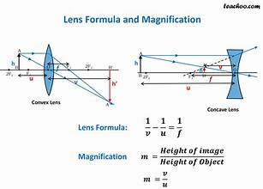

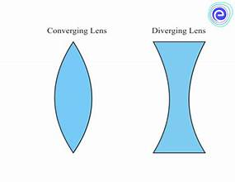
Lensmaker's equation
The focal length of a lens in air can be calculated from the lensmaker's equation
where
f is the focal length of the lens;
n is the refractive index of the lens material;
R1 is the (signed, see below) radius of curvature of the lens surface closer to the light source;
R2 is the radius of curvature of the lens surface farther from the light source; and
d is the thickness of the lens (the distance along the lens axis between the two surface vertices).

Slide 8
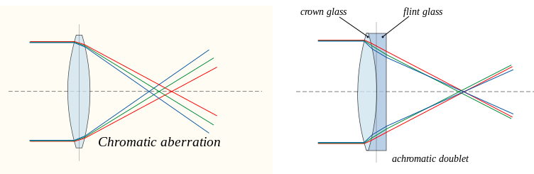
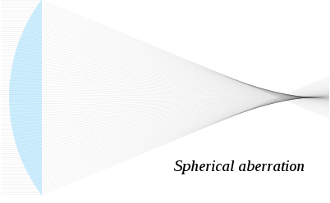
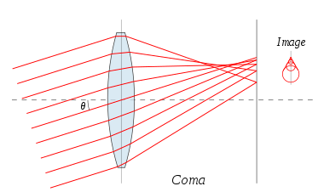
Aberrations:
Spherical aberration:
Spherical aberration occurs because spherical surfaces are not the ideal shape for a lens, but are by far the simplest shape to which glass can be ground and polished, and so are often used. Spherical aberration causes beams parallel to, but distant from, the lens axis to be focused in a slightly different place than beams close to the axis. This manifests itself as a blurring of the image. Spherical aberration can be minimised with normal lens shapes by carefully choosing the surface curvatures for a particular application. For instance, a plano-convex lens, which is used to focus a collimated beam, produces a sharper focal spot when used with the convex side towards the beam source.
Chromatic aberration:
Chromatic aberration is caused by the dispersion of the lens material—the variation of its refractive index, n, with the wavelength of light. Since, from the formulae above, f is dependent upon n, it follows that light of different wavelengths is focused to different positions. Chromatic aberration of a lens is seen as fringes of colour around the image. It can be minimised by using an achromatic doublet (or achromat) in which two materials with differing dispersion are bonded together to form a single lens. This reduces the amount of chromatic aberration over a certain range of wavelengths, though it does not produce perfect correction. The use of achromats was an important step in the development of the optical microscope. An apochromat is a lens or lens system with even better chromatic aberration correction, combined with improved spherical aberration correction. Apochromats are much more expensive than achromats.

Slide 9
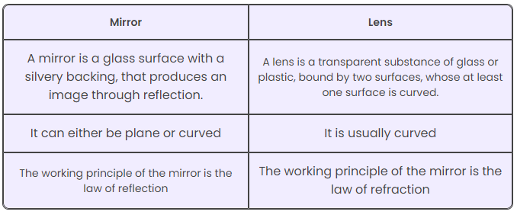
Applications Of Lens:
What do magnifying lenses, your eye, and binoculars have in common? They all use convex lenses. And have any of you wondered why people look so weird when seeing them through a peephole? That’s because the glass used there isn’t a normal one. It is a concave lens. Convex lenses are used to correct farsighted vision problems.
Similarly, concave lenses are used to correct nearsightedness. Compound microscopes and telescopes use both convex and concave lenses. Using combinations of convex lenses may create blurry images. A concave eyepiece is used to correct this problem. Even in cameras, at times, a combination of concave and convex lenses is used. The use of concave lenses is essential in lasers. The actual light ray is particular, which may damage equipment where it is used (like CDs and scanners). The diverging lens rectifies this issue. Concave lenses also apply in flashlights where the light beam diverges for broader coverage.
A watch with a plano-convex lens over the date indicator
A single convex lens mounted in a frame with a handle or stand is a magnifying glass.
Lenses are used as prosthetics for the correction of refractive errors such as myopia, hypermetropia, presbyopia, and astigmatism. (See corrective lens, contact lens, eyeglasses, intraocular lens.) Most lenses used for other purposes have strict axial symmetry; eyeglass lenses are only approximately symmetric. They are usually shaped to fit in a roughly oval, not circular, frame; the optical centres are placed over the eyeballs; their curvature may not be axially symmetric to correct for astigmatism. Sunglasses' lenses are designed to attenuate light; sunglass lenses that also correct visual impairments can be custom made.
Other uses are in imaging systems such as monoculars, binoculars, telescopes, microscopes, cameras and projectors. Some of these instruments produce a virtual image when applied to the human eye; others produce a real image that can be captured on photographic film or an optical sensor, or can be viewed on a screen. In these devices lenses are sometimes paired up with curved mirrors to make a catadioptric system where the lens's spherical aberration corrects the opposite aberration in the mirror (such as Schmidt and meniscus correctors).
Convex lenses produce an image of an object at infinity at their focus; if the sun is imaged, much of the visible and infrared light incident on the lens is concentrated into the small image. A large lens creates enough intensity to burn a flammable object at the focal point. Since ignition can be achieved even with a poorly made lens, lenses have been used as burning-glasses for at least 2400 years.[6] A modern application is the use of relatively large lenses to concentrate solar energy on relatively small photovoltaic cells, harvesting more energy without the need to use larger and more expensive cells.
Radio astronomy and radar systems often use dielectric lenses, commonly called a lens antenna to refract electromagnetic radiation into a collector antenna.
Lenses can become scratched and abraded. Abrasion-resistant coatings are available to help control this.

